Slide 1
Fairfield County Commercial Brokers Network
Pick the best cover for your presentation and delete the other options
Once Pitchbook is completed, please save as a PDF and attach Pitchbook as a Salesforce Task.
Financial Relationship Guidebook
Prepared By: Debbie Clancy
deborah.clancy@td.com
Date:
March 28, 2025

Slide 2
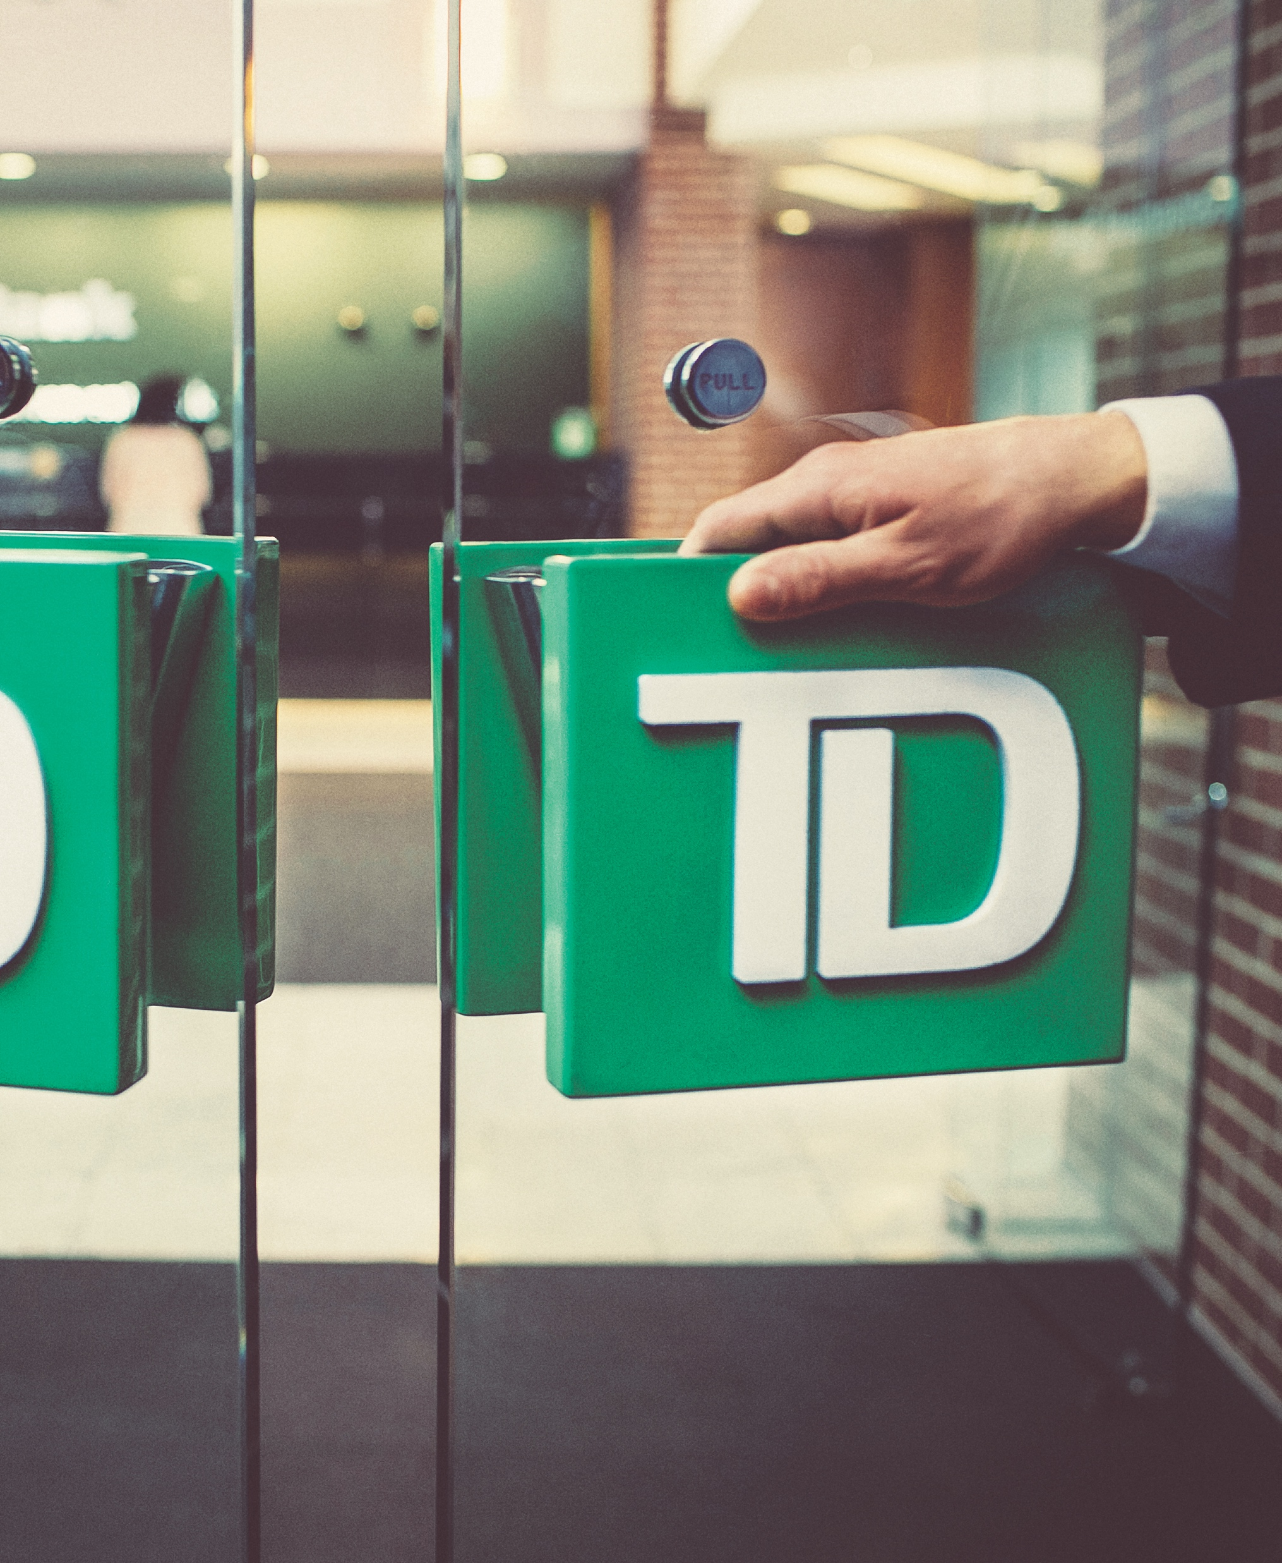

Introducing
TD Bank
About us
Your team
Our commitment

Slide 3
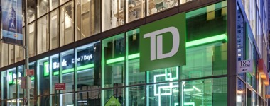
Who is TD Bank Group?
  We are one of the largest banks in North America, with over $1.9 trillion CAD in assets and over 27 million Customers. Headquartered in Toronto, Canada the Toronto-Dominion Bank and its subsidiaries are collectively known as TD Bank Group ("TD"). With 92,000 employees in offices around the world, TD Bank Group offers a full range of products and services.
Choose this page for legacy CSB prospects
Key Business Lines
TD Bank, N.A.
TD Securities
Asset Based Lending
Vehicle & Dealership Financing
Commercial Banking
Commercial Real Estate
Equipment Finance
Global Trade Finance
Higher Education
Institutional Healthcare
Merchant Solutions
Municipal Finance
Retail Banking
Treasury Management Solutions
Wealth Institutional Sales
Wealth Private Client Group
Provides a wide range of capital market products and services to corporate, government and institutional clients looking for experience in key areas of finance:
Investment Banking
Capital Markets
Commodities & FX
Derivatives
Prime Brokerage

Slide 4
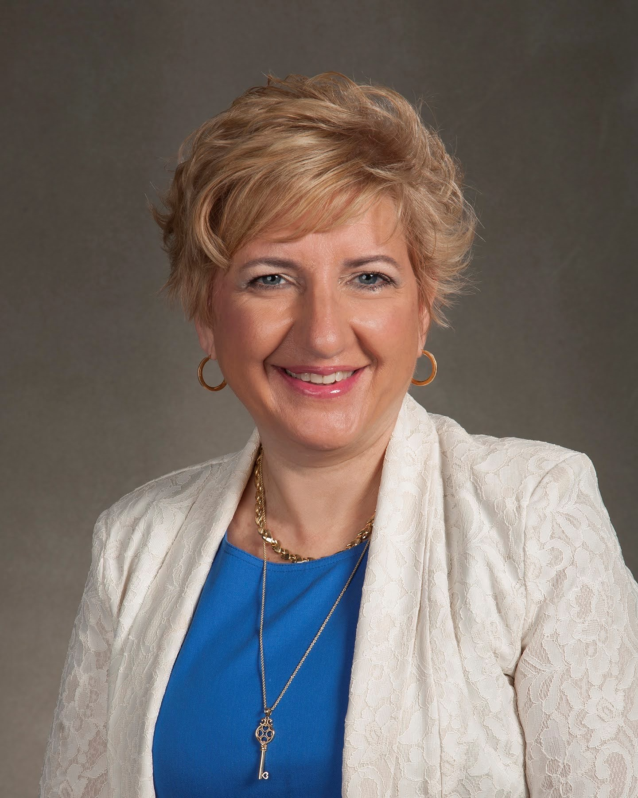
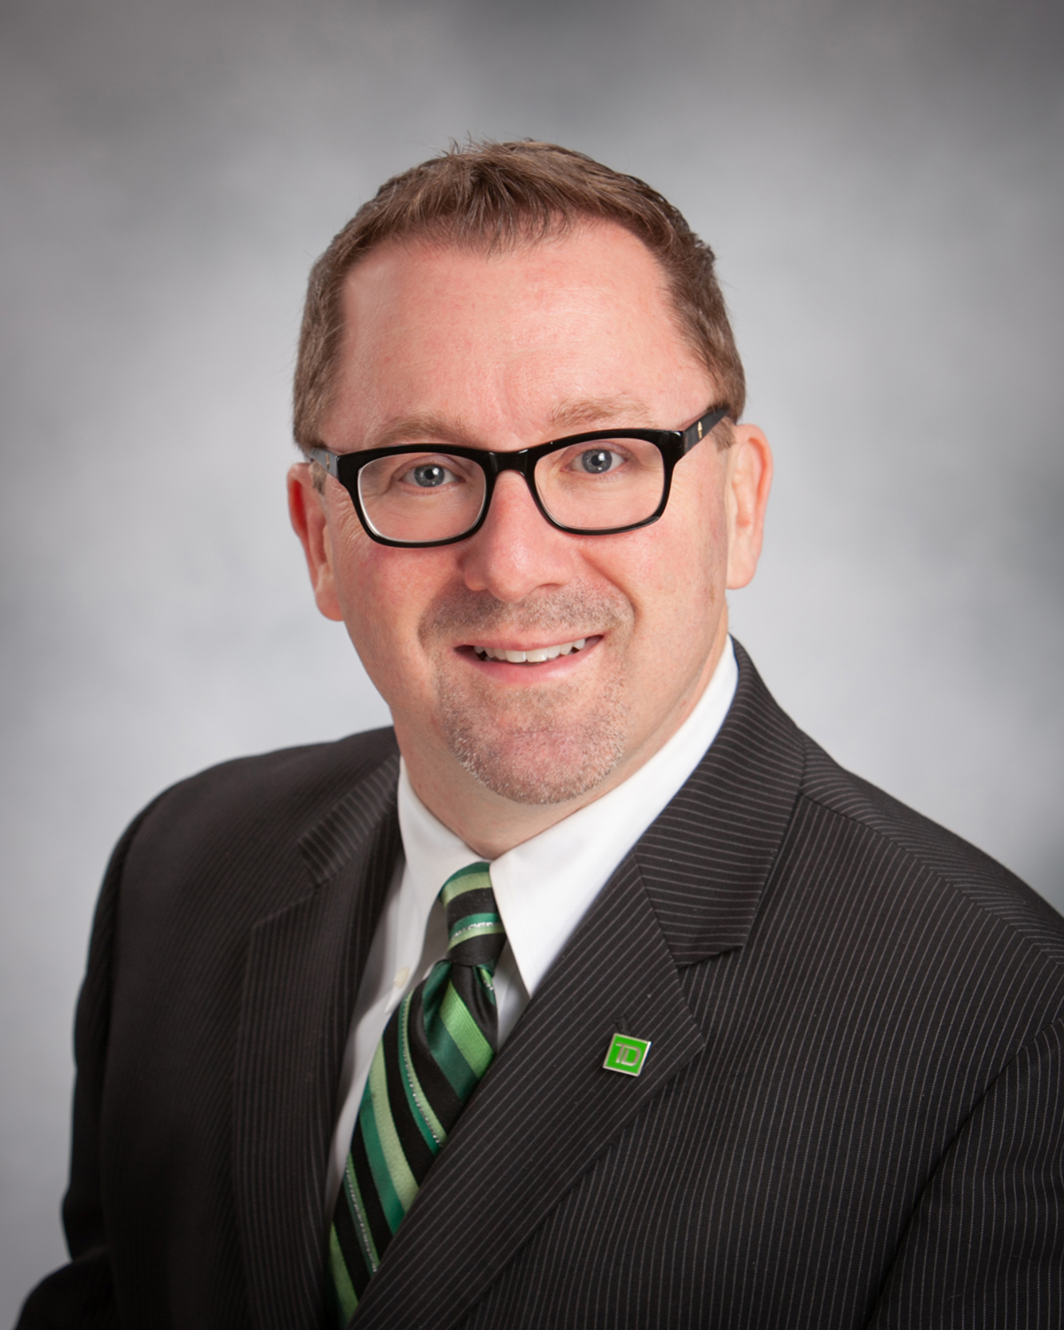


Your TD Bank Team
Debbie
Clancy
Michael
Lye
Vice President and Senior Relationship Manager
203-605-6500
Deborah.clancy@td.com
Relationship Manager
203-893-8718
Michael.lye@td.com

Slide 5


Commercial Real Estate
We offer a comprehensive suite of commercial real estate credit, deposit and treasury management solutions that our CRE team will customize for your client's specific needs. Our offerings span across all asset classes via various loan products and terms. In addition to our relationship-centric approach, we are also deeply dedicated to the communities we serve and actively invest in projects that encourage growth in economically distressed markets.
TD received an
Outstanding Rating
We can deliver a variety of customized solutions to meet your unique needs.
Our industry experts serve a wide range of clients.
  Local, Regional and National Developers and Owners
  Real Estate Investment Trusts
  Private Equity Real Estate Funds
  DUS Lenders
  Community Development Firms
  High Net-Worth Individuals and
  Family Offices
Loans
Tax Credit Offerings
  Long-term Fixed and Variable Rate Loans
  Bridge Loans
  Construction Loans
  Construction Loans with Mini-Perm Options
  Mortgage Loans (floating and fixed, up to 10 years)
  Bond-Supporting Letters of Credit
  Low Income Housing Tax Credit
  New Markets Tax Credit
TD Securities Offerings
  Derivatives/Interest Rate Hedging
  Syndications
  Public & Private Debt Placements
  Equity Capital Markets

Slide 6
Small Business Administration Loans
When you're ready to expand your business, you’ll want to consider an SBA loan, which offers lower equity requirements and longer terms than conventional loans. Our SBA Business Development Officers have years of experience helping business owners secure the capital they need to grow. As a Preferred SBA Lender, we're able to guide you through the process with faster decision times and loan approvals than non-SBA preferred lenders.
#1 SBA lender. TD is the top lender on the East Coast for low long-term fixed rates.¹
Support. Our experienced Business Development Officers, Credit Underwriting and Closing Groups help the approval and closing process run smoothly and efficiently.
Trust and integrity. We'll strive to become your trusted SBA finance specialists, dedicated to helping you achieve what’s best for you and your business.
Features
10% required equity contribution and 20-25 year terms
SBA 7(a) loans up to $5MM
504 loans maximums from $5MM to no limit (depending on industry)
Low equity requirements
No balloon payments²
Our experience
Real estate purchases and refinance
Expansion and acquisition
Partnership buy-outs
Equipment purchases
Franchise financing
Construction
Visit tdbank.com/sba for more information.
¹ Lenders ranked by the U.S. Small Business Administration (SBA) based on the SBA’s data for the units of loans approved during the period 10/1/119 to 9/30/20. in its Maine-to-Florida footprint in the SBA's top two lending products: 7(a) and 504 loans.
² No balloon payment when amortization is 20 years or less. Loans and line of credit subject to credit approval. Some credit restrictions may apply. Other terms and conditions may apply.

Slide 7

Restaurant Franchise Finance Group
Get full coverage for your business needs
Remodels
Equipment purchasing
Refinancing
Acquisitions, recapitalizations and buyouts
Sponsored transactions
Succession planning
Real estate
Experience personalized service
Flexible lending terms
Competitive rates
Treasury and merchant solutions
Personal wealth management and retirement planning services
Manage all of your finances in one place
Our support extends beyond your restaurant to all of your business banking needs. Your local Relationship Manager can also help you with SBA loans, treasury management and commercial credit cards.
Whether you're remodeling or expanding your franchise, you'll get expert service. We'll customize solutions to support your short- and long-term plans and help keep your finances flexible for your day-to-day business needs.
With deals starting at around $5 million and the ability to arrange syndications in excess of $100 million, you'll find financing that fits independent restaurants as well as regional and national franchises.¹
¹ Loans and lines of credit subject to credit approval. Some credit restrictions may apply. Other terms and conditions may apply.
Visit tdbank.com/franchise for more information.

Slide 8

Putting TD to work for you and your clients
A proven track record with organizations of all sizes

Slide 9

Recent transactions
Leverage the 'Deal Announcement' database to fill in recent and relevant tombstones.
If you have a new deal to highlight, make sure you have a signed release form allowing us to publicize these deals. (Sharepoint site)
$9MM Commercial Mortgage
Purchase of a Supermarket anchored shopping plaza
10 year term
25 year amortization
$1.2MM Commercial Mortgage
Purchase of the Strip Shopping Center
Ridgefield, CT
10 year term
20 year amortization
$1MM Commercial Mortgage
Purchase of 3 condos for investment purposes
Fairfield, CT
5 year term
20 year amortization
$1.1MM Commercial Mortgage SBA 7A
Owner Occupied Retail Space
^{$4.5MM}
^{Industrial/Flex space}
^{Wallingford, CT}
5-year term
25-year amortization

