Slide 1




FCCBN FOUNDER:
SPONSORED BY:
LOCATION PROVIDED BY:
1

Slide 2
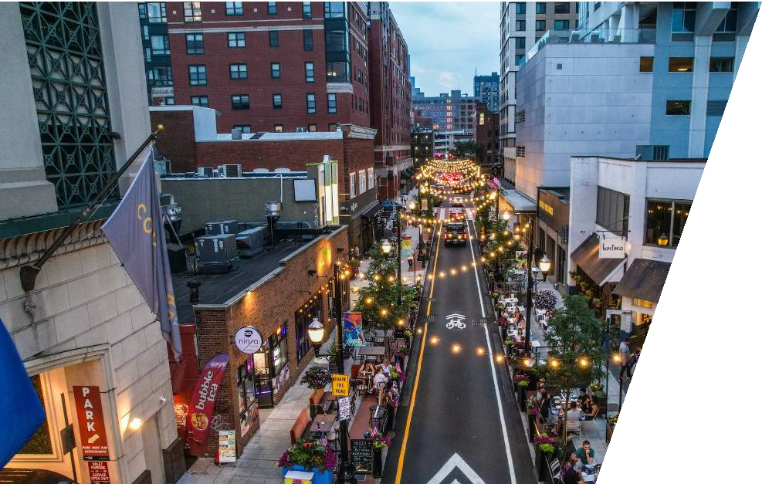
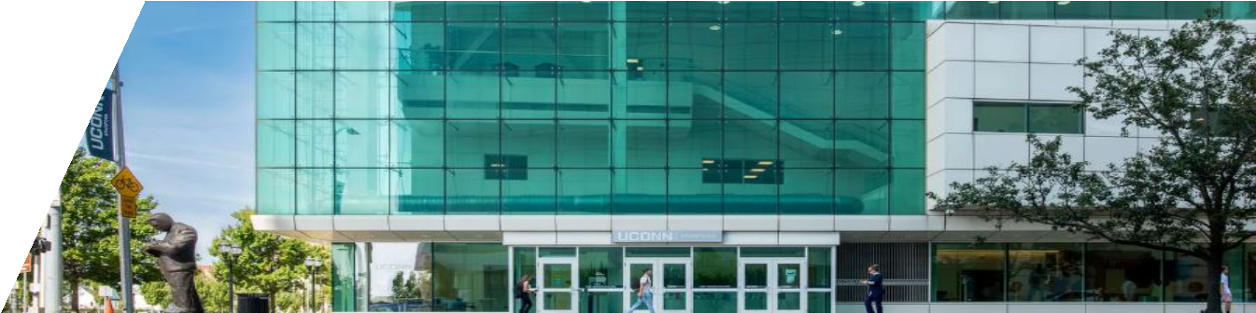
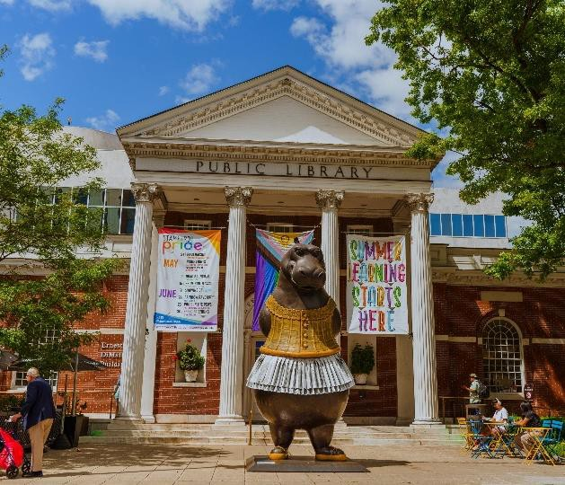

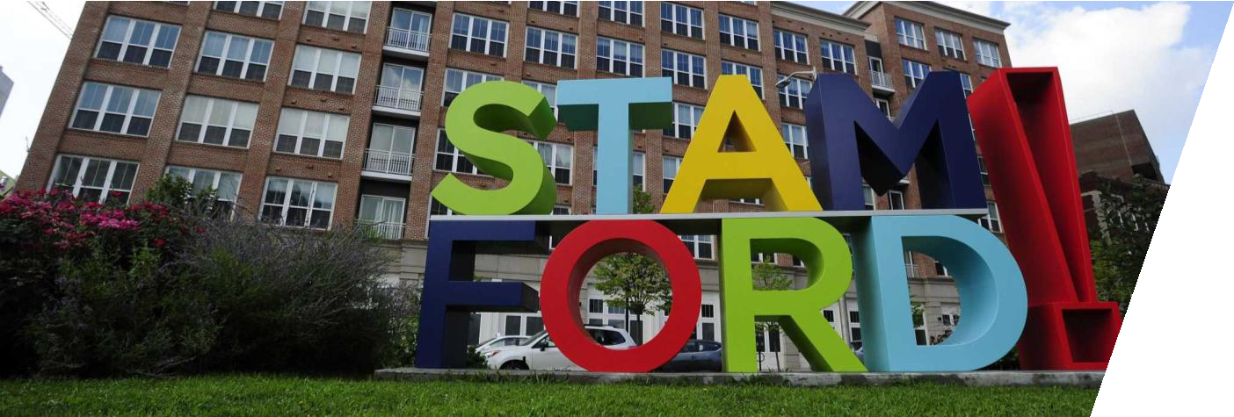

City of Stamford
Fairfield County Commercial Brokers Network Presentation
September 25, 2026 Mayor Caroline Simmons

Slide 3

Mayor’s Vision and Budget Priorities
Vision:
Creating a more inclusive, equitable, vibrant, affordable, and innovative city where everyone can thrive.
City Priorities:
Invest in critical services and infrastructure projects to enhance quality of life for residents, while maintaining a balanced and fiscally responsible budget.
Key priority areas:
  Public Safety – Vision Zero, traffic enforcement, neighborhood beautification efforts, pedestrian safety
  Infrastructure – Schools, roads, sidewalks, parks, train
station, housing
  Parks and Sustainability – Climate Action Plan, Coastal Resilience Plan
  Roads, Sidewalks, & Pedestrian Safety
  Economic Prosperity – Stamford Tech Hub, workforce development, business retention and attraction

Slide 4
Economic Outlook
City of Stamford Population: 135,470 people
Stamford Statistics:
  2nd largest city in Connecticut
  2nd highest grand list in the state ($27.4B)
  Ranked the safest city in New England, with a population of over 100,000
  15th most diverse city for our size
  Only big city with a AAA bond rating
Business Growth:
Major League Soccer Lazarus Home Care Pure Barre
NanZiang Ziao Long Bao Steward Partners Versant
MoneyCorp Wings Arena STM Fieldhouse Rumble Boxing
Sabor Latino Restaurant IVX Health
Commercial Vacancy Rate: 23.1%.
Unemployment Rate:
  Stamford: 3.6%
  Connecticut: 4.2%
  United States: 4.4%

Slide 5
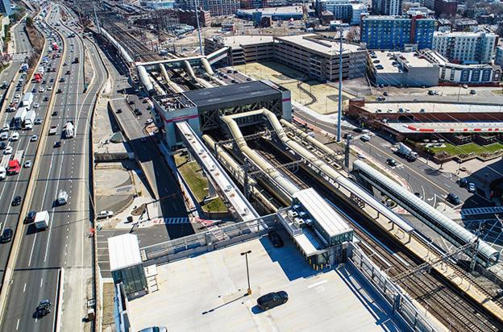
Stamford Transportation Center
CTDOT issued an RFP for the Redevelopment of Stamford Transportation Center.
CTDOT is in the process of finalizing selection and plans to
announce the selection of development teams by October 2026.
Stakeholders will be engaged throughout the next phase of the process.

Slide 6
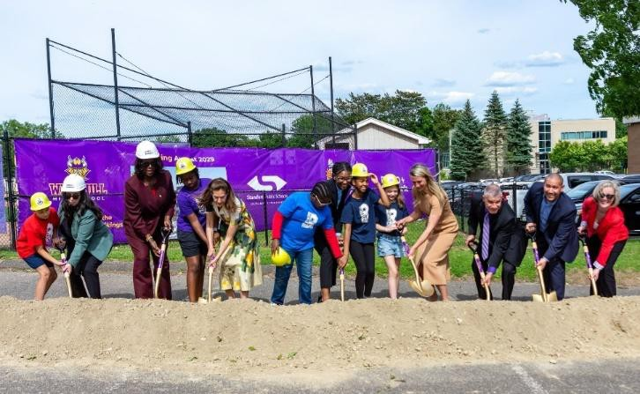
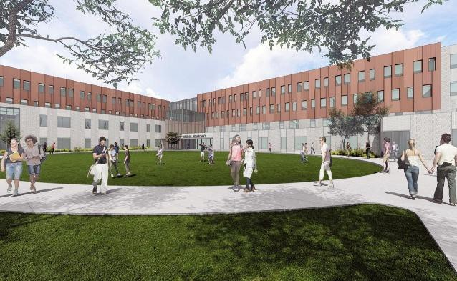
Westhill High School Groundbreaking
On June 2, we were joined by local and state leaders, including Lieutenant Governor Susan Bysiewicz and Deputy Commissioner for the Department of Administrative Services Eleanor Michael, for the groundbreaking of the new Westhill High School.
Designed to accommodate up to 2,458 students, the new Westhill High School will feature nearly 100 classrooms, including general education, science, special education, and specialized learning spaces designed to support the school’s many career pathway programs, as well as a state-of-the-art indoor pool. 80% of the project cost will be reimbursed by the State of Connecticut.
To stay up-to-date with all the school enhancement projects across Stamford Public Schools, visit: spsbuilds.com.

Slide 7
Economic Development Priorities
Small Business Support
Business Recruitment
Launched “Unicorn” marketing campaign at the Stamford Transportation Center and in New York City.
Continue to host small business resource events and information sessions that offer networking opportunities and connect entrepreneurs with local, state, and regional organizations that provide access to capital and support services.
Over 100 businesses have attended these events this year.
Workforce Development
Since launching last year, the Stamford Tech Hub has trained hundreds of residents at its headquarters at Charter Communications.
Participants receive free technology training in fields such as software development, cybersecurity, data analytics, and digital media.

Slide 8
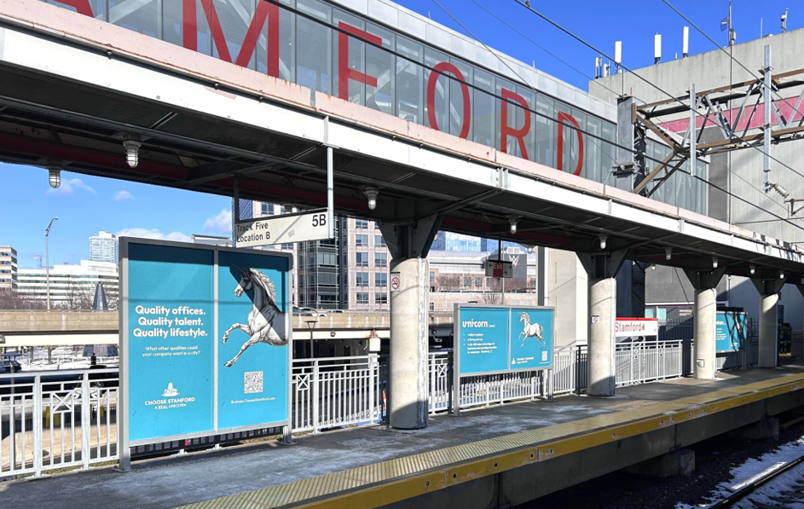
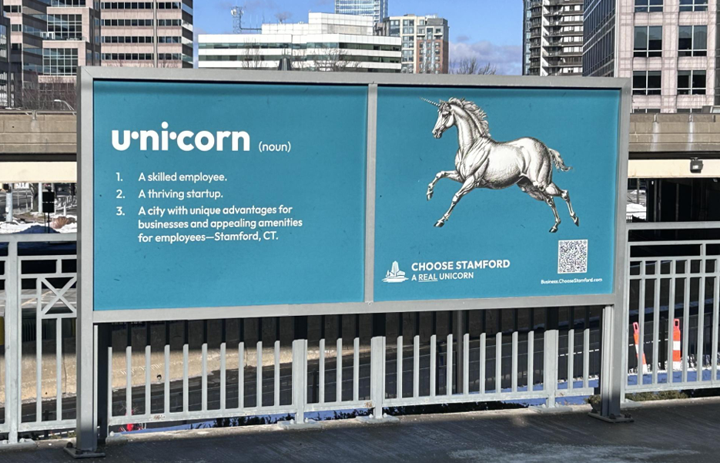
It’s Not Make Believe…It’s Stamford!

Slide 9
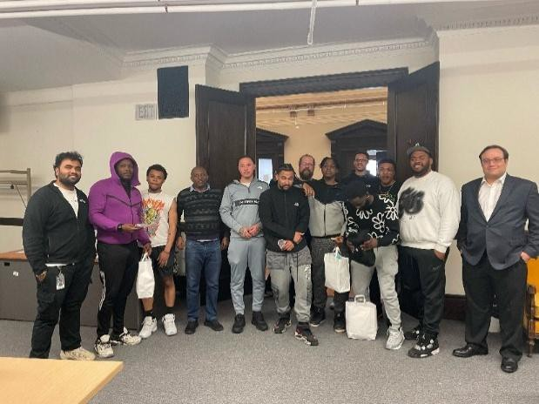

Stamford Tech Hub
In April 2025, the City of Stamford Office of Economic Development launched the Stamford Tech Hub in partnership with Charter Communications, the Stamford Partnership, and DAE.
With a $5 million investment from Charter and support from Webster Bank, this initiative provides free, hands-on tech training in software development, cybersecurity, data analytics, and digital media, plus mentorship, career coaching, and flexible learning options.
For more details on these programs, visit stamford.mydae.org or email adminsupport@mydae.org.
3-Week Program Graduating Class

Slide 10
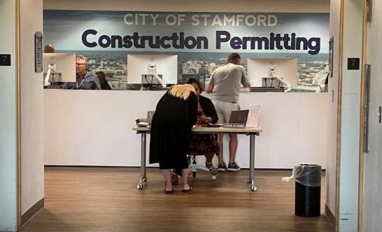
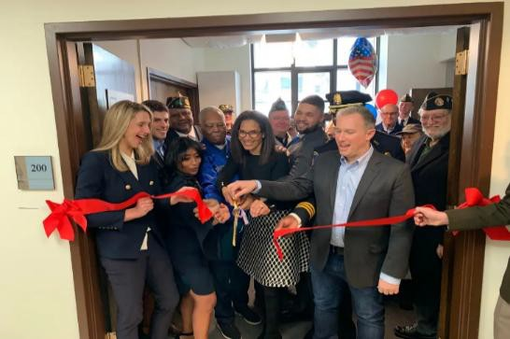
Responsive Government Initiatives
My administration is committed to making government work better and be more responsive to residents’ needs. Below is a snapshot of the progress we have made toward these goals:
Enhanced the Fix It Stamford dashboard; year-to-date, the Citizen’s Service team has fielded 2,625 calls and received to 9,758 Fix It requests. The Government Center security desk now has “Fix It Stamford” business cards that provide the Citizen’s Service phone number, email, and a QR code to the website.
Made the Stamfordct.gov website accessible in over 100 languages.
Established a permanent walk-in permitting center on the 7th floor of the Government Center; reduced the average permitting wait time from two years to 90 years. The Walk-In Permitting Center is open weekly on Wednesdays from 8:30 am – 10:30 am.
Created the Stamford Veterans Resource Center, a place for veterans and their families to be connected to resources and services. The Veterans Resource Center has helped over 300 veterans, providing lifesaving support services, and now offering mental health counseling through the Westchester County Vets Center. The Veterans Resource Center is open on Tuesdays and Thursdays from 10:00 am – 1:00 pm.

Slide 11
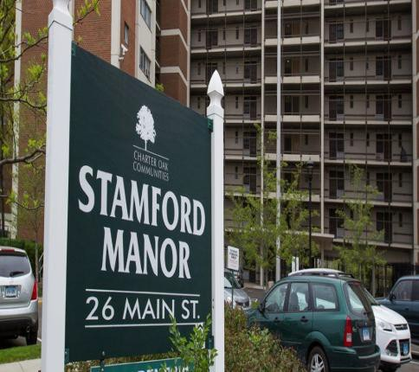
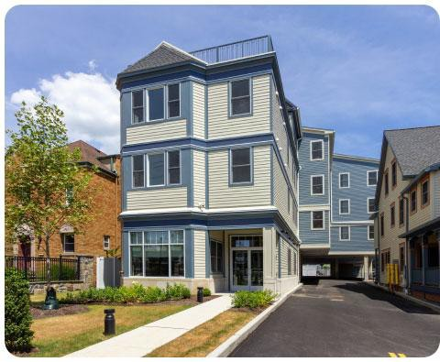
Affordable Housing Executive Order Updates
In 2023, I signed Stamford’s first Affordable Housing Executive Order, setting a goal to create or renovate 1,000 affordable units by 2025. To date, more than 700 units have been completed or are underway.
Key initiatives include:
Approved sale of 41 Main Street (Midas property) for 55 units of affordable housing.
Oak Park Phase 1 (Charter Oak Communities): 61 affordable rentals (25%–60% AMI); $3.45M in BMR funds, $1.25M Capital Budget,
$750,000 Trust Fund.
Continued allocation of city capital budget funding to support the
construction or renovation of deeply affordable housing.
Affordable Housing Trust Fund – as of June 18, 2026, there is $195,859 to be allocated at the July 15, 2026, meeting.
Increased the requirements for developers to build affordable housing units onsite.
Increased the Below Market Rate housing requirements from 12% to 14%.

Slide 12
Public Safety Investments
Technology Infrastructure Enhancements and Upgrades:
  Added blue light cameras, parks and coastline camera enhancements.
  Emergency Communications Center hardware and software
upgrades.
Personnel Investments:
  Civilianized the 911 Emergency Operations Center for staffing efficiency.
  Added five additional police officers and additional Fire
Deputy Chiefs.
  Opened the Stamford Regional Police Academy at the Stamford Police Department.
Public Safety Capital Investment Projects
  $4.3 million for fire apparatus – three new fire pumper apparatus.
  $620k new 33’ full cabin police patrol boat.
Cybersecurity Enhancements – implemented comprehensive cybersecurity upgrades and launched a Secure Cyber City initiative.
School Safety Communications – improved emergency communications for school safety, including a monthly emergency test text message.

Slide 13
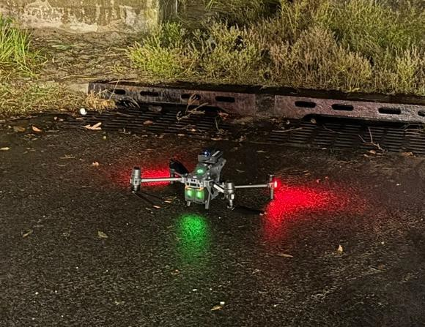
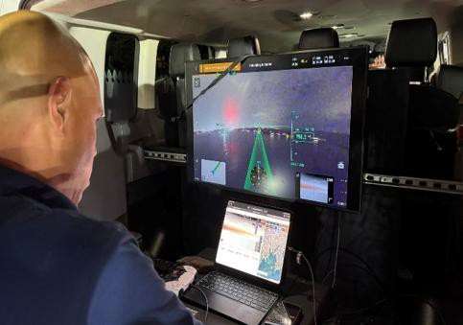
Drone as a First Responder Program
In October 2025, we launched the Public Safety Drone as First Responder Program. This innovative initiative – developed through a collaboration between Stamford’s 911 Emergency Communications Center, the Stamford Fire Department, and the Stamford Police Department – marks a major step forward in leveraging cutting-edge technology to improve emergency response and public safety in Stamford.
Faster Response: Drones will be deployed from strategically located sites in North and South Stamford, providing citywide coverage with a response time of under 90 seconds.
Real-Time Awareness: Live video feeds from drone cameras will be streamed directly to command staff and field personnel, improving coordination and decision-making.
Enhanced Safety: Drones will help assess threats, monitor unfolding incidents, and support safer responses for both first responders and the public.
Resource Efficiency: Early visual assessments will allow emergency services to better determine the appropriate level of response for each incident.

Slide 14
State & Federal Funding
In partnership with Governor Ned Lamont and Stamford’s state and federal delegations, the City secured funding for the following projects:
$2 million for Charter Oak Communities to complete Phase
2 of the Charter Oak Park redevelopment project.
$2 million for renovations to the basketball court and playground at Hatchfield Park
$1.2 million to install safety measures along Washington Boulevard, including ADA-compliant sidewalks, bicycle facilities, and a raise crosswalk.
$1.09 million to replace aging culverts and installing tidal controls on stormwater outflow pipes, which will expand the city’s stormwater management capacity.
$1.03 million to support the design and construction of a new public safety complex to enhance emergency response capabilities.
$480,000 for the Stamford Museum & Nature Center to support the new Planetarium and Astronomy Center.
$250,000 to rehabilitate the Glenbrook Community Center.
Since the Trump administration took office, the federal funding landscape has dramatically changed. We continue to work closely with our federal lobbyist to navigate these impacts, and we will continue to seek out funding to invest and support the City of Stamford.

Slide 15
